Slide 1
CSS Columns
Tutorial #23

Slide 2
OBJECTIVE

Slide 3
Objective
The objective of this tutorial is not necessarily to teach columns, but to convey the idea that you can use CSS to define a basic layout for any page and reuse that layout as you see fit.

Slide 4
TEXTPLANATION

Slide 5
Textplanation
You’ve spent the last several tutorials working with advanced CSS concepts, most notably classes and positioning. Like all other programming, you want to use CSS to your advantage, making the code as portable (reusable) as possible. I think that the best way to see this is through the construction of columns.css, so why don't you just jump right into that.

Slide 6
CONSTRUCTION

Slide 7
Construction
Create a folder somewhere on your drive and label it CSS Columns.
Open up notepad++.
You will need 2 files for this construction:
index.html (provided for you)
columns.css
The construction will jump back and forth between the files so be aware of the changes.
This is a very long construction. Have patience and take your time with it. Refresh the page EVERY TIME YOU CHANGE THE CODE.

Slide 8
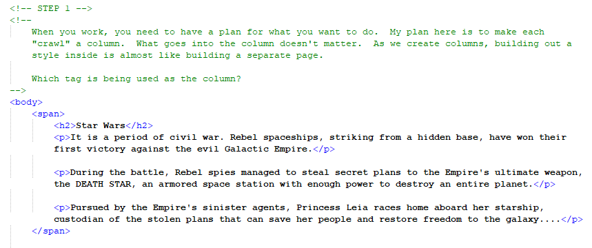
Construction

Slide 9
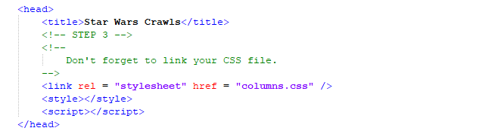
Construction

Slide 10
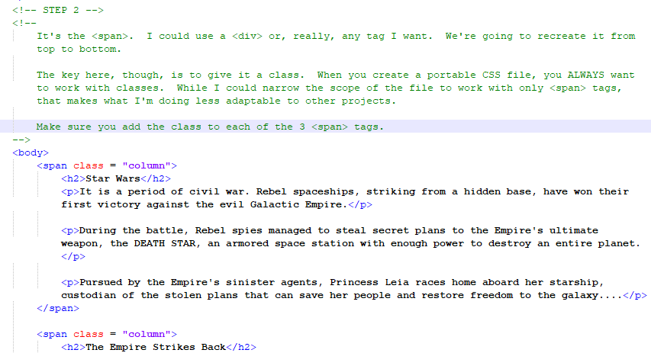
Construction

Slide 11
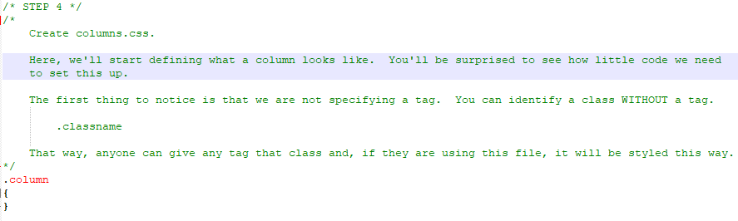
Construction

Slide 12
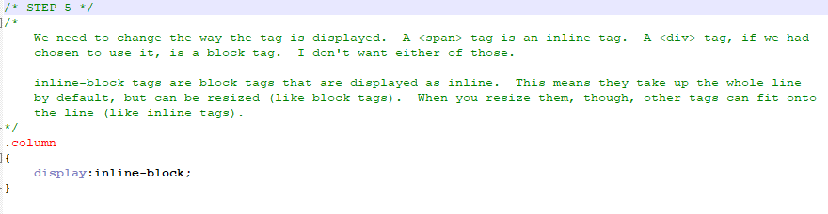
Construction

Slide 13
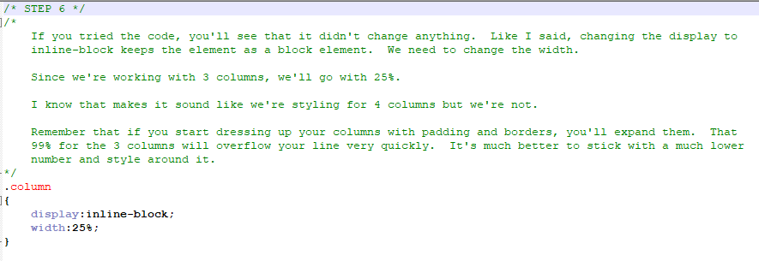
Construction

Slide 14
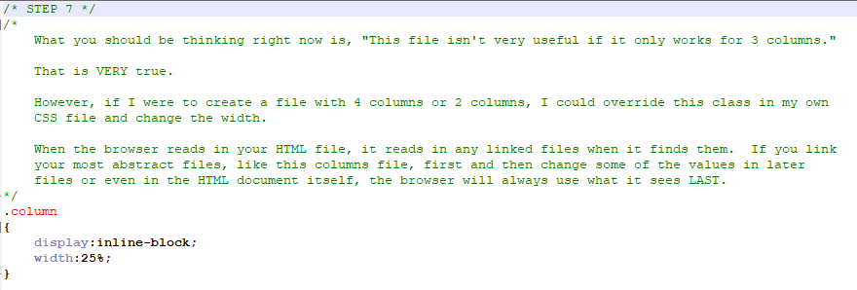
Construction

Slide 15
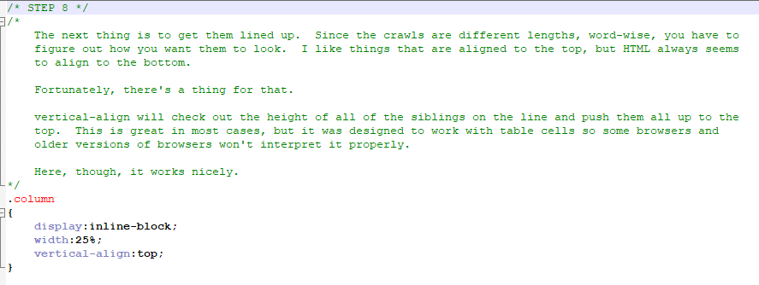
Construction

Slide 16
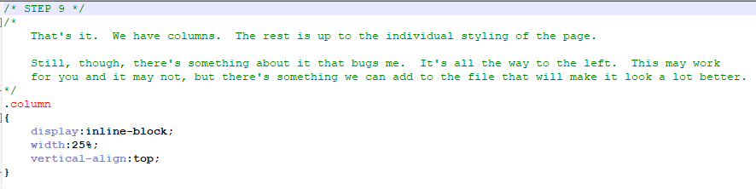
Construction

Slide 17
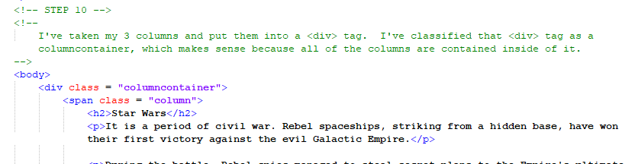
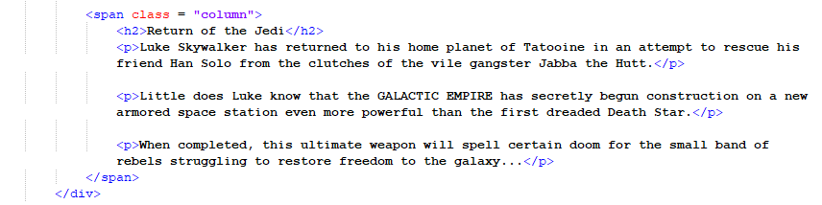
Construction

Slide 18
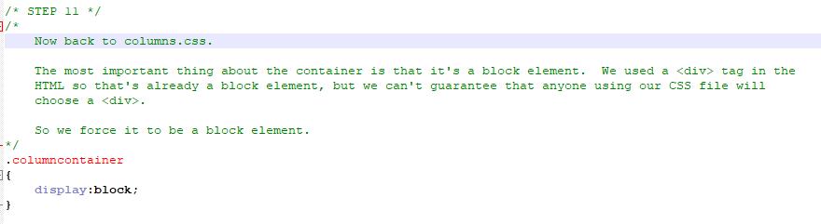
Construction

Slide 19
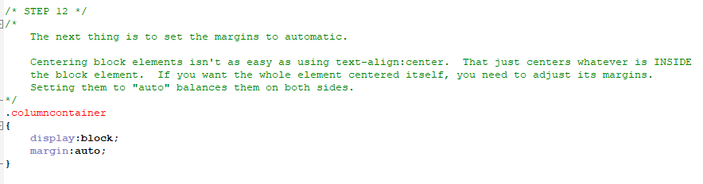
Construction

Slide 20
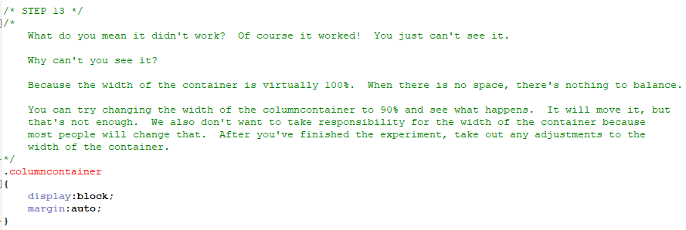
Construction

Slide 21
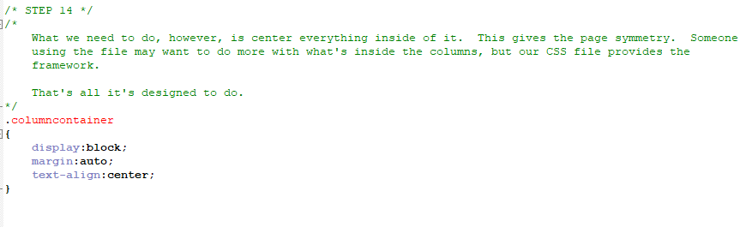
Construction

Slide 22
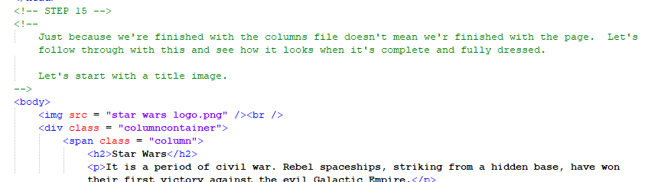
Construction

Slide 23
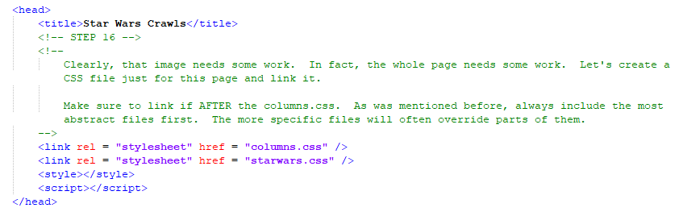
Construction

Slide 24
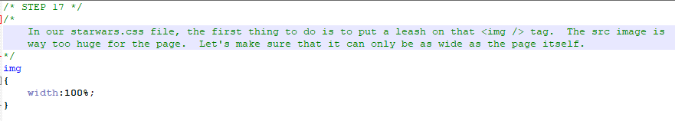
Construction

Slide 25
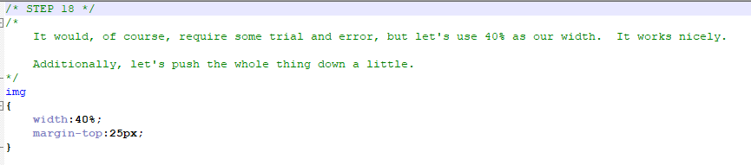
Construction

Slide 26
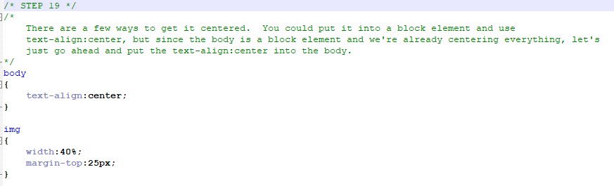
Construction

Slide 27
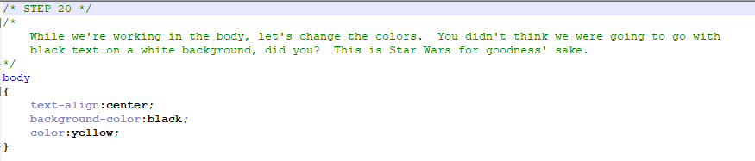
Construction

Slide 28
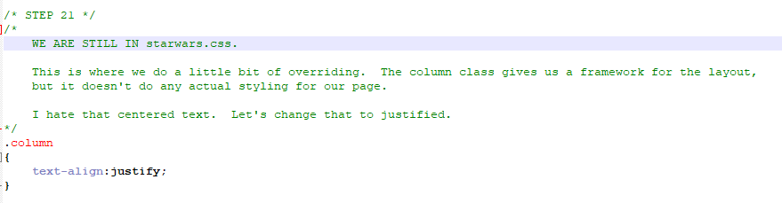
Construction

Slide 29
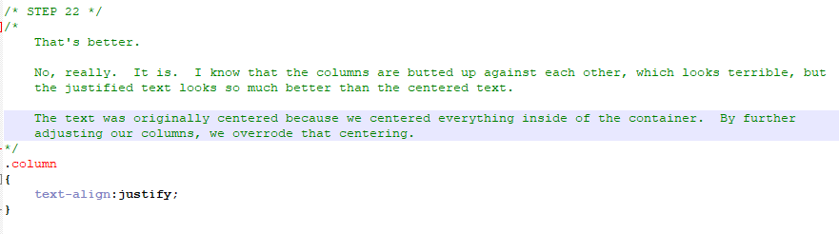
Construction

Slide 30
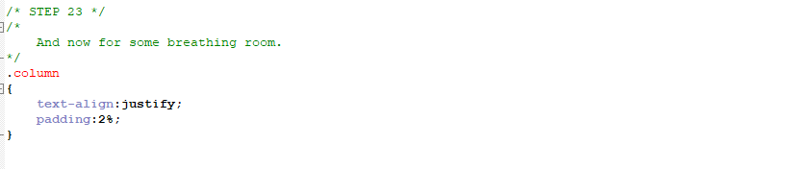
Construction

Slide 31
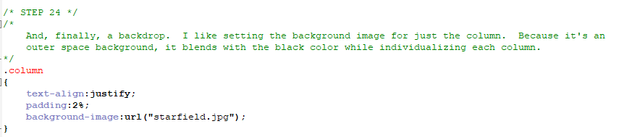
Construction

Slide 32
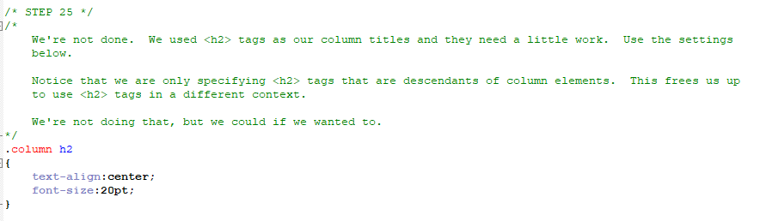
Construction

Slide 33
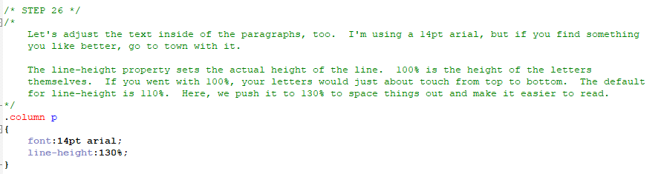
Construction

Slide 34
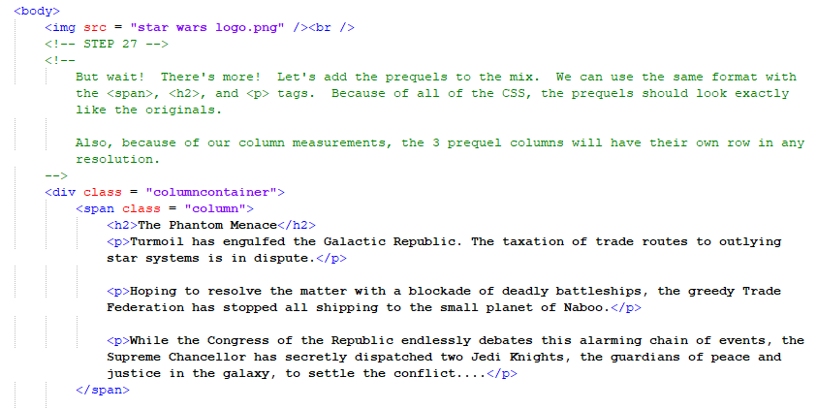
Construction

Slide 35
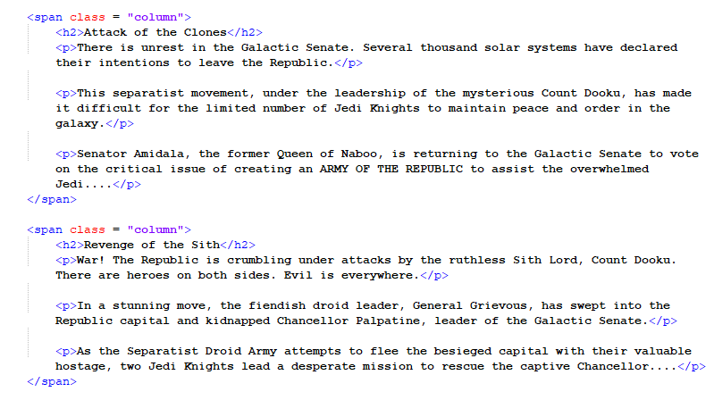
Construction

Slide 36
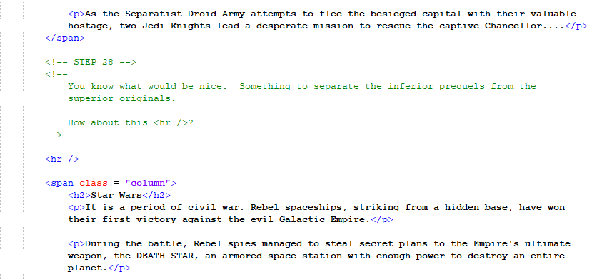
Construction

Slide 37
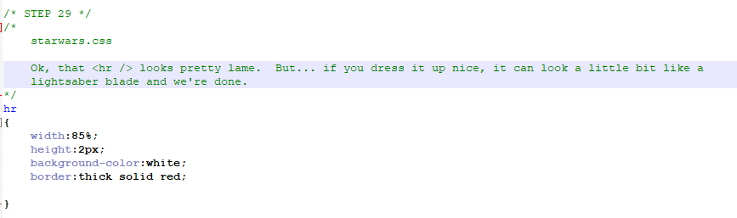
Construction

Slide 38
Construction
Now that it’s done, you should try something. Go online and get the text for the crawls for The Force Awakens and The Last Jedi. These are the 2 most recent Star Wars movies.
Add these 2 crawls to the bottom of the page and see how the columns.css design handles them.
It’ll be nice.
Trust me.

Slide 39
A DEEPER MEANING

Slide 40
A Deeper Meaning
The deeper meaning here comes from your takeaway. I'm sure you will adopt the code from the construction and use it in your projects as is. That’s fine as long as you're always looking for a way to adapt it to your own needs. However, you need to walk away from this tutorial thinking that columns represent one type of layout. You can use CSS in this way to create multiple layouts for use on different pages that need to present a different user experience.

Slide 41
FAQ

Slide 42
FAQ
Question?
Answer.

Slide 43
ACTIVITY

Slide 44
Triangle Proof
Included with this tutorial is an image called “tp screenshot.png”. Your activity is to use code this image in HTML and use columns.css as a basis for the styling. Remember that you may need to override some of the code from columns.css in your own css file or in the <style> tag.
Here are some helpful pieces of information:
The statements and reasons are in tables.
The title is in an <h1>
The problem and the word “Solution” are both in <h2> tags.
In the top table, each cell has an <input /> tag so that the user would be able to enter in his or her own responses.
The solution table does not have <input /> tags. On a working page, the user would hover the mouse over a statement or reason and see the solution (you do not have to implement this interface).

